Slide 1
Physician Distress: It’s Moral Injury, Not Burnout
Wendy Dean, MD

Slide 2
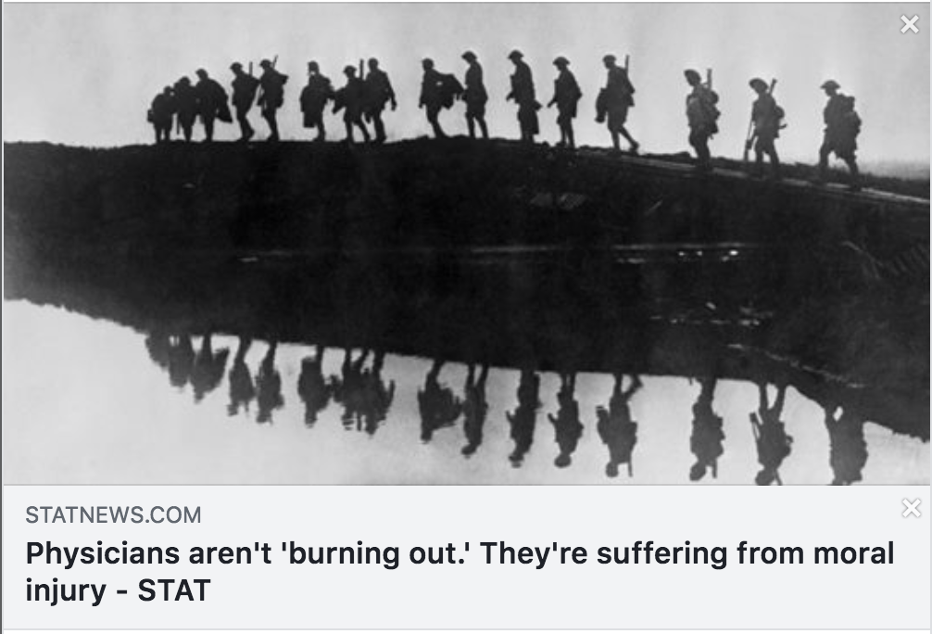
The Inception
26 July 2018
Notes:
We received responses from all around the world, and from every type of provider. This is a widespread problem. While my talk will focus largely on physicians, since that is my area of most awareness, most of what I discuss applies to all types of healthcare providers.

Slide 3
Physician suicide: a disturbing statistic…
An under-addressed ‘problem’
~400 each year
~900,000 physicians in the US
44/100k→”Code Lavender”, resilience training, wellness committees
288 military suicides in 2014
1.3M Active Duty + 850k Reservists
22/100k→$100M in funding to study the problem and address the causes

Slide 4
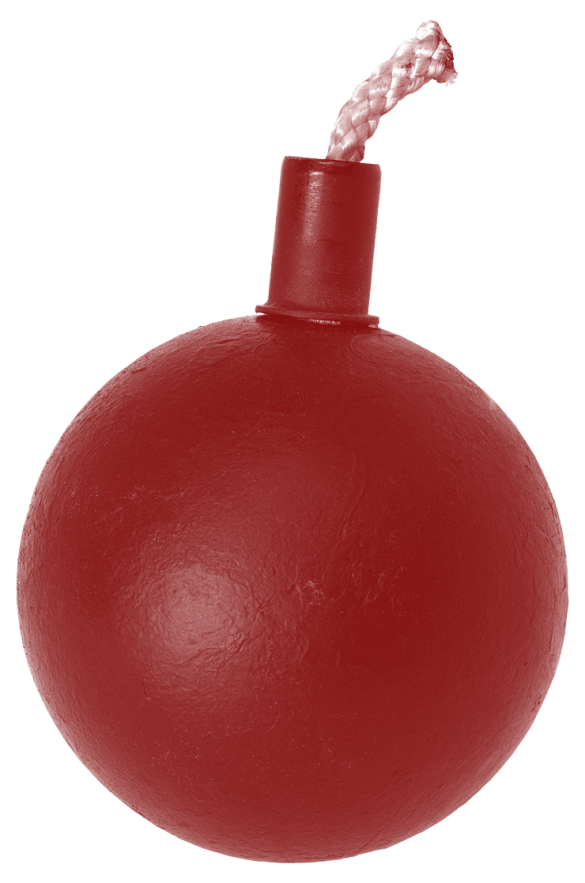
What is “burnout”?
Exhaustion
Cynicism and detachment
Ineffectiveness and lack of accomplishment.
Impacts:
54-78%
~$1M
900k
Notes:
54.4% exhibit at least one symptom of “Burnout”—Merritt Hawkins 2018 survey
It costs up to $1M to replace each physician who leaves a system
Each year, ~900k patients are left without a physician, because of physician suicides, early retirement, or relocation

Slide 5
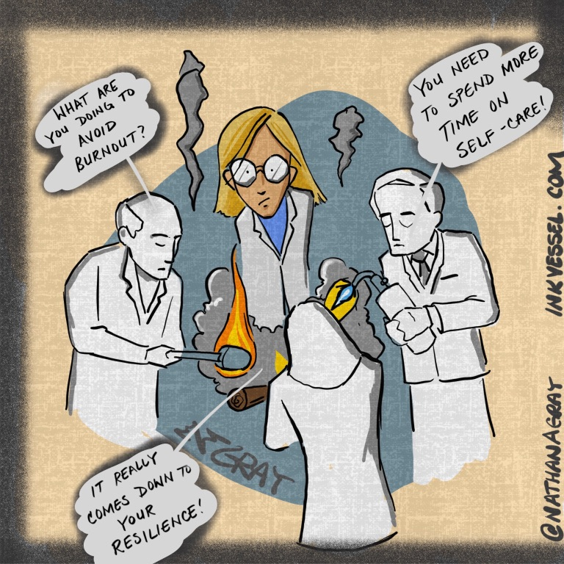
The problem with the term “burnout” . . .
It implies a lack of resilience
It shifts responsibility for the crisis—and its solutions—onto individual physicians
It fails to acknowledge the complexity of the drivers of distress
It is victim blaming

Slide 6
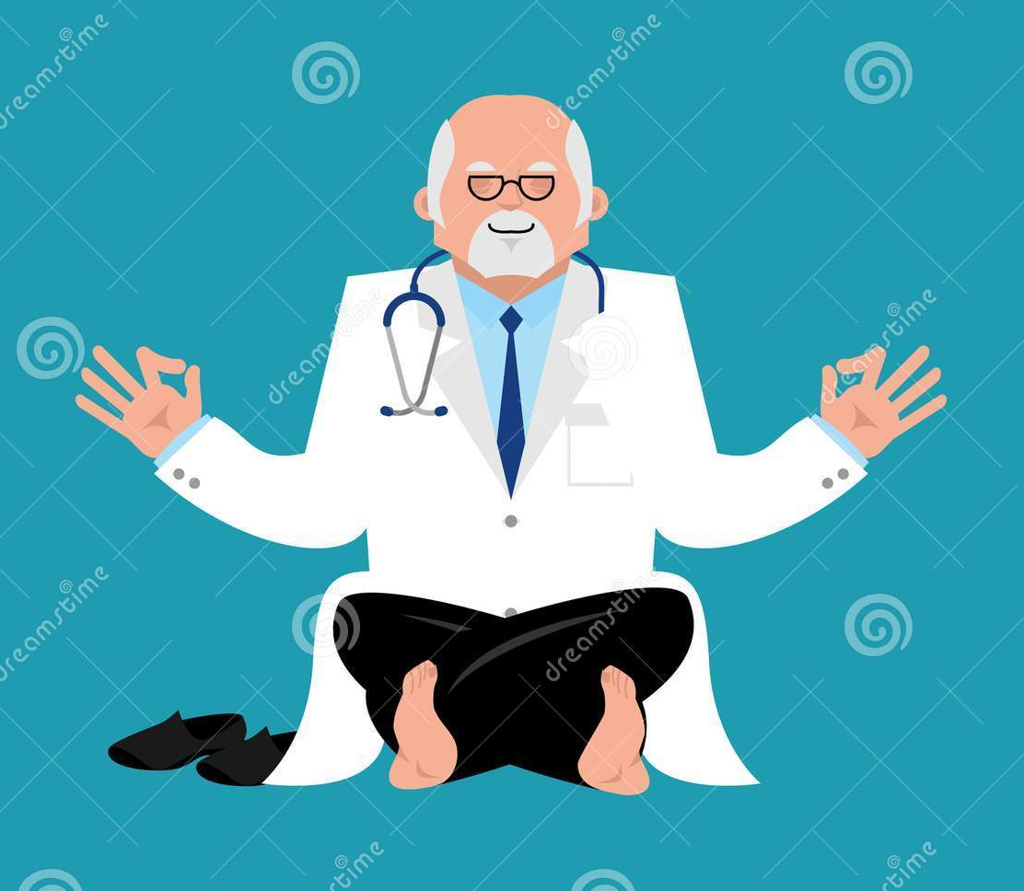
A note on resilience-based approaches…
Resilience is necessary in a high-intensity career
Yoga is probably good for most people
Exercise is part of a balanced lifestyle
Eating well is important
Work-life integration is appropriate
Most physicians have robust resilience
Symptomatic approaches do not attack the root causes of distress
www.dreamstime.com

Slide 7
Moral Injury
“. . . a deep soul wound that pierces a person’s identity, sense of morality, and relationship to society” ~Diane Silver
“. . . perpetrating, failing to prevent, bearing witness to, or learning about acts that transgress deeply held moral beliefs and expectations.” ~Brett Litz, et. al.
www.army.mil
Notes:
The term was first used to describe an invisible wound inflicted on soldiers when they witnessed or perpetrated unspeakable acts in the context of war. Unlike PTSD, which is a fear-based response to life-threats, moral injury is, as Nancy Sherman at Georgetown describes it, the feeling of existential disorientation--a feeling of the erosion of a sense of goodness and humanity.

Slide 8
Moral injury in physicians
Physician oaths:
In every house where I come I will enter only for the good of my patients. Hippocrates, 5th century BC
The health of my patient will be my first consideration. Declaration of Geneva
I will apply, for the benefit of the sick, all measures which are required . . . Modern Hippocratic Oath
I shall always act in the best interest of my patient. The Oath of the Healer
Insurance constraints
Preauthorization
Network limits
Hospital demands
Leakage mandates
EHR
Billing/Coding
Satisfaction surveys
Productivity requirements
Notes:
So, how does this relate to medicine?
Nearly every physician takes some type of oath. And virtually every one of those oaths describes the physician’s obligation to put the needs of the patient first.

Slide 9
The drivers of moral injury…
“The increasingly complex web of providers’ allegiances—to patients, to self, and to employers—and its attendant moral injury may be driving the health care ecosystem to a tipping point and causing the collapse of resilience.”

Slide 10
Elements of Physician Satisfaction
Purpose
Autonomy
Mastery
Respect
Reward

Slide 11
How?
Boundaries
Physician leaders who have not forsaken their commitment to clinical care
Working together
Understanding the environment in which we work and how to influence change

